Slide 1
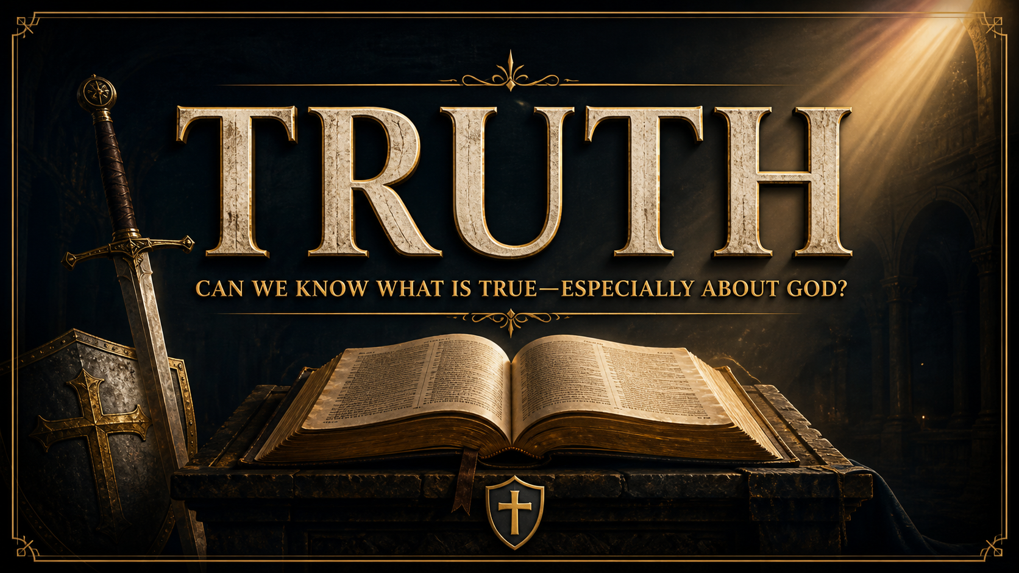
Notes:
What is the contradictions in the stats?
They are saying the Bible or our religion isn’t true, while most of them will say you cant know absolute truth.
Who’s fault is this? Parents, Grandparents, any guardian or Church member who has a personal relationship as a maternal relationship to this child.
Proverbs 22::6 “train up a child in the way he should go; even when he is old he will not depart from it.” Then in Col. 2:6-8 “Therefore, as you received Christ Jesus the Lord, so walk in Him, just as you were taught, abounding in thanksgiving. See to it that no one takes you captive by philosophy and empty deceit, according to human tradition, according to the elemental spirits of the world, and not according to Christ.”
May be the first time they are challenged on Christianity.
Equip when the time comes, it will.

Slide 2
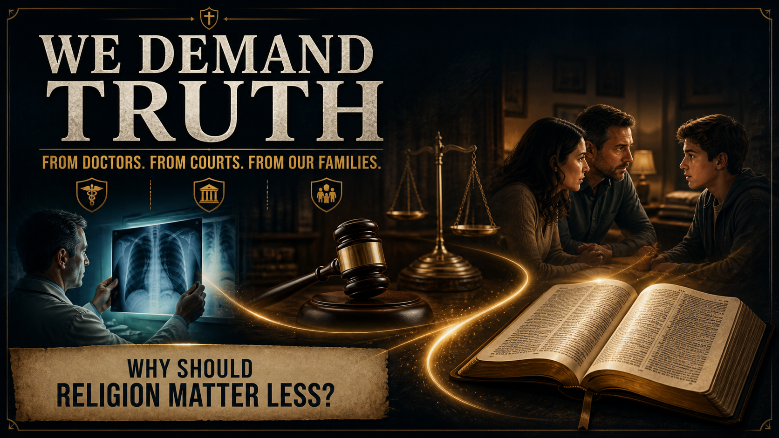
Notes:
We demand truth, when we see the immediate or not an extended time period, result of a lie, health, money, court, relationships
Yet when morality or religions, we get my truth vs your truth. Why do we think that is?
But if religious claims concern reality—God, human purpose, morality, death, and eternity—then truth matters here at least as much as it does anywhere else.

Slide 3
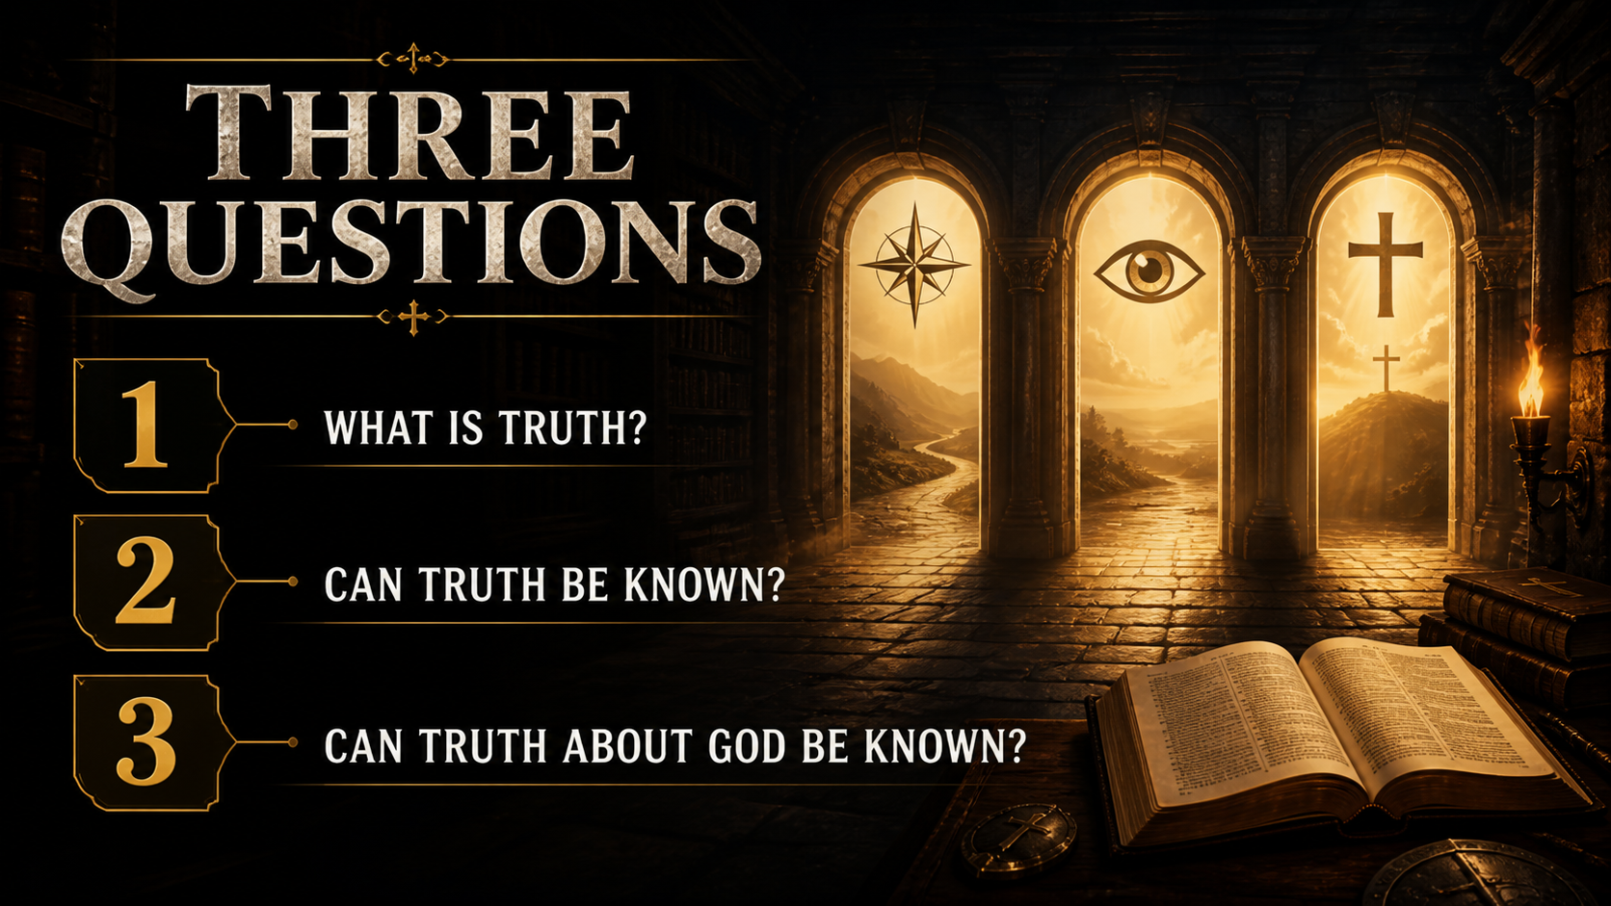
Notes:
Foundation.
Use these to evaluate claims against, but also for Christianity.

Slide 4
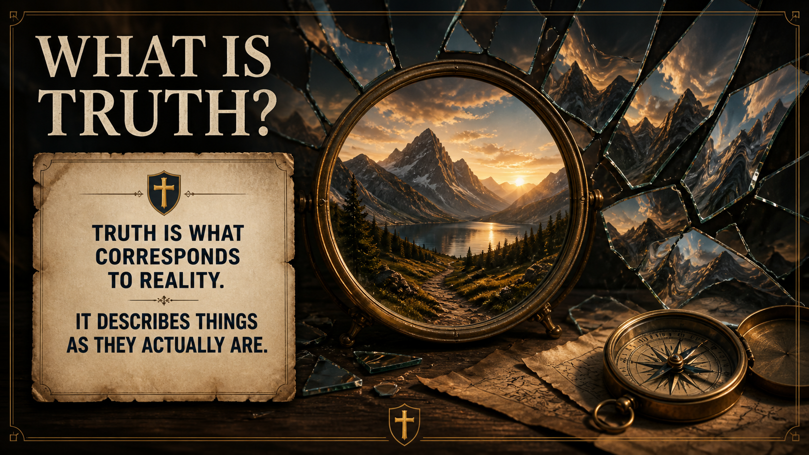
Notes:
Absolute, true all people, all the time, regardless of discovery.
Gravity, discover not the same as creating.
Doesn’t become true or false whether we believe or reject. Belief can change, truth cant.
Flat vs Round Earth.

Slide 5
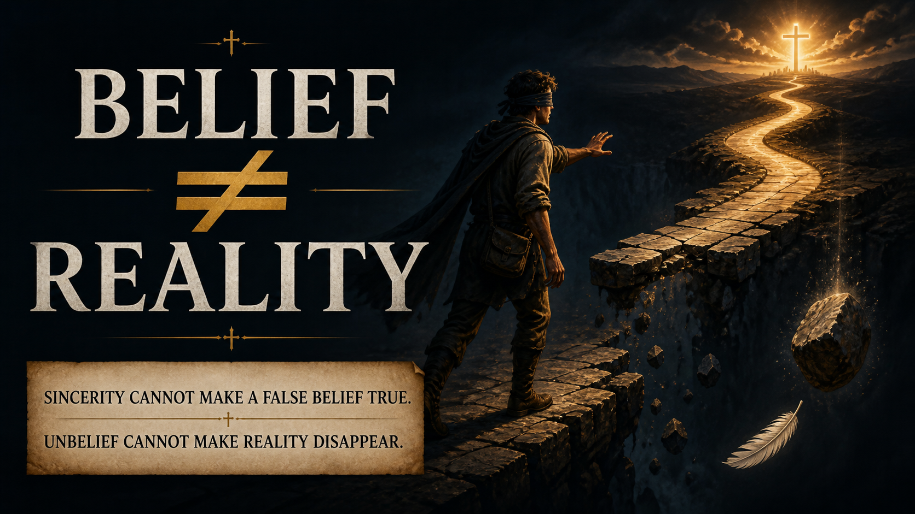
Notes:
A person can sincerely believe something false. Refusing to believe in gravity does not make someone float. Christianity is not true merely because Christians believe it sincerely; if it is true, its claims must correspond to reality and be supported by adequate reasons.

Slide 6
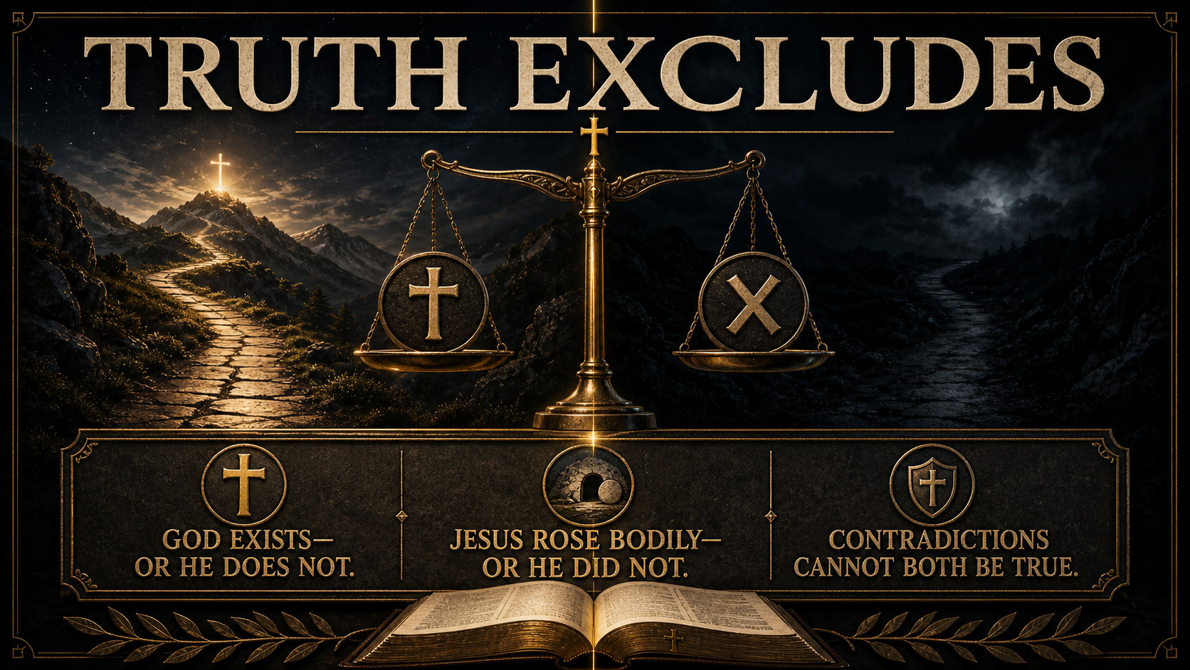
Notes:
Different religions may share moral teachings, but their central claims conflict.
Claiming Christianity is exclusive is exclusive.

Slide 7
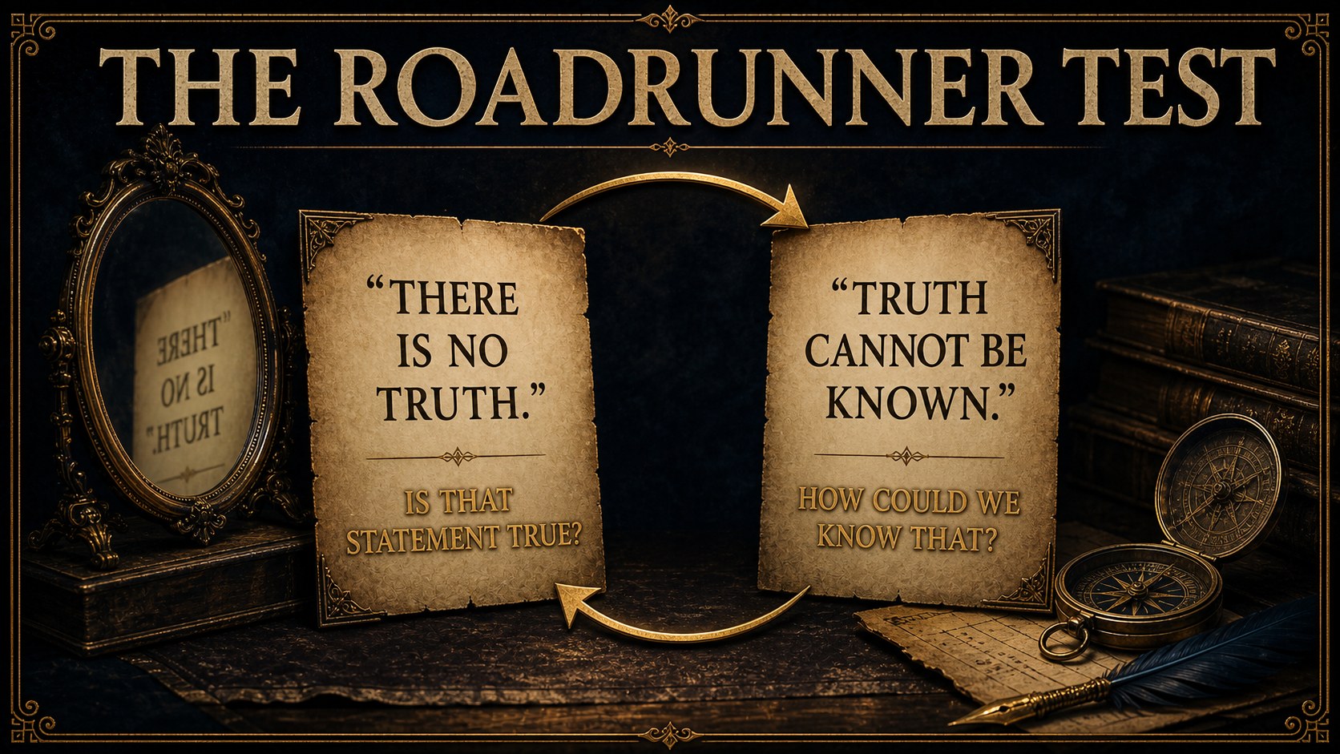
Notes:
IDHEFTBAA – Norman Geislar & Frank Turek. Apply a skeptical claim to itself.
No absolute truth denies itself by making a statement of absolute.
We don’t know everything. Skepticism about everything, causes you to have to skeptical about skepticism. The more skeptical about skepticism you are, the more true you are making the claim itself.

Slide 8
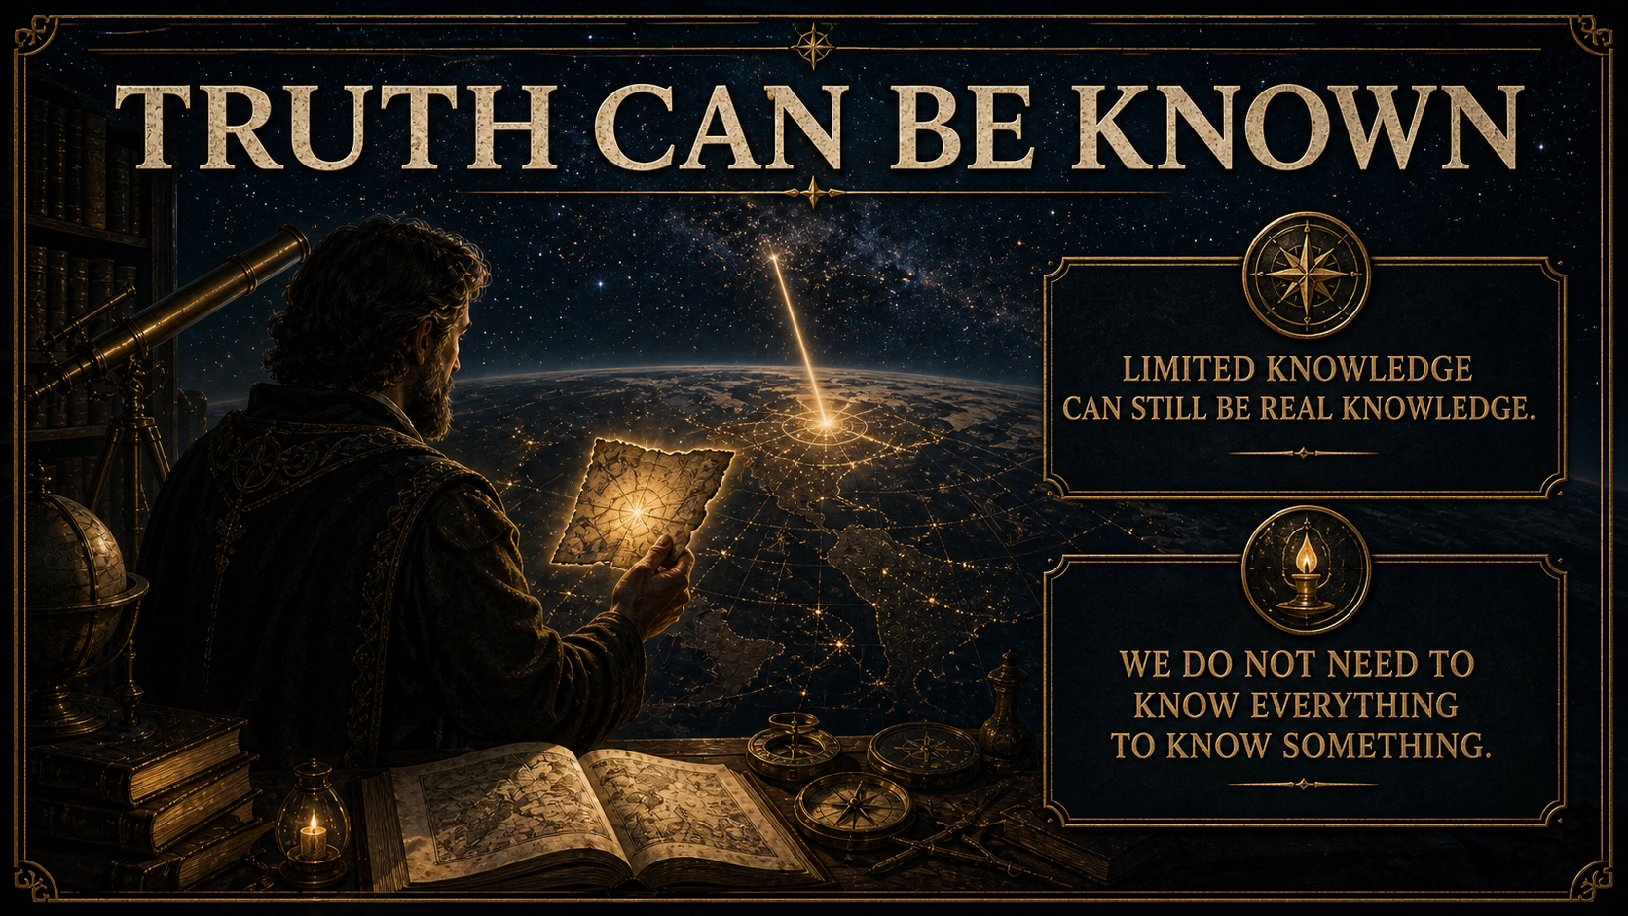
Notes:
Human knowledge is limited, but limited knowledge is not the same as no knowledge.
Gravity, we may not understand how it works or why, but we recognize the effects.
Certainty, highly probable, beyond reasonable doubt.

Slide 9
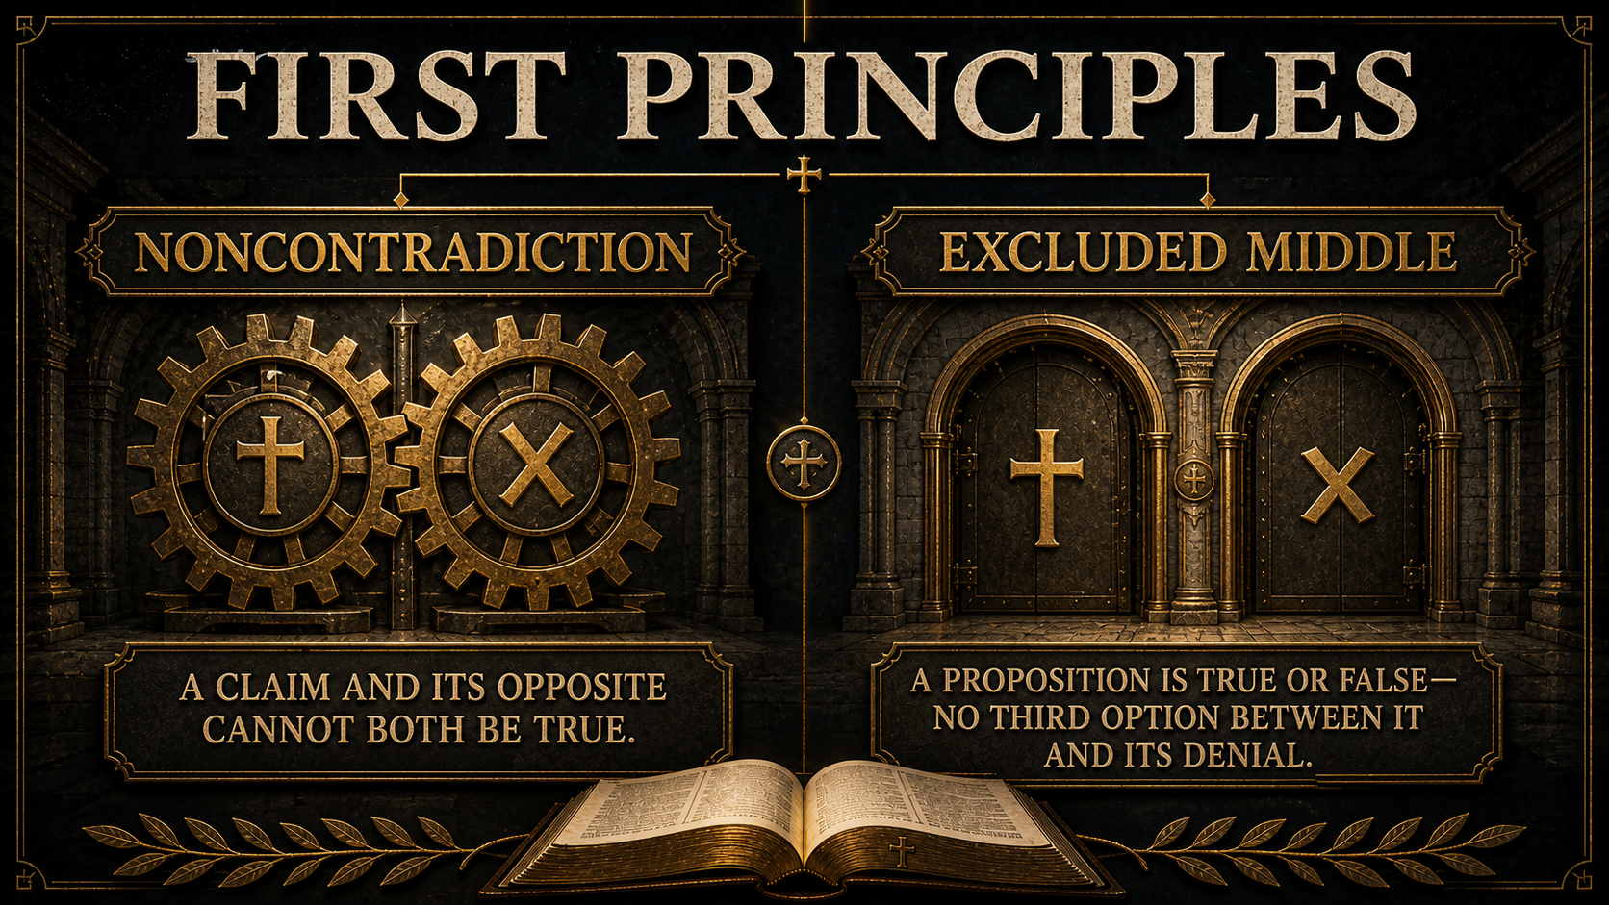
Notes:
First because nothing comes before.
Law of Non-Contradiction. Tell Pregnancy story.
Law of Excluded Middle. God exist or he doesn’t, no third option.
These principles make rational thought possible.
Can’t tell us if our claim is true, allows reason.

Slide 10
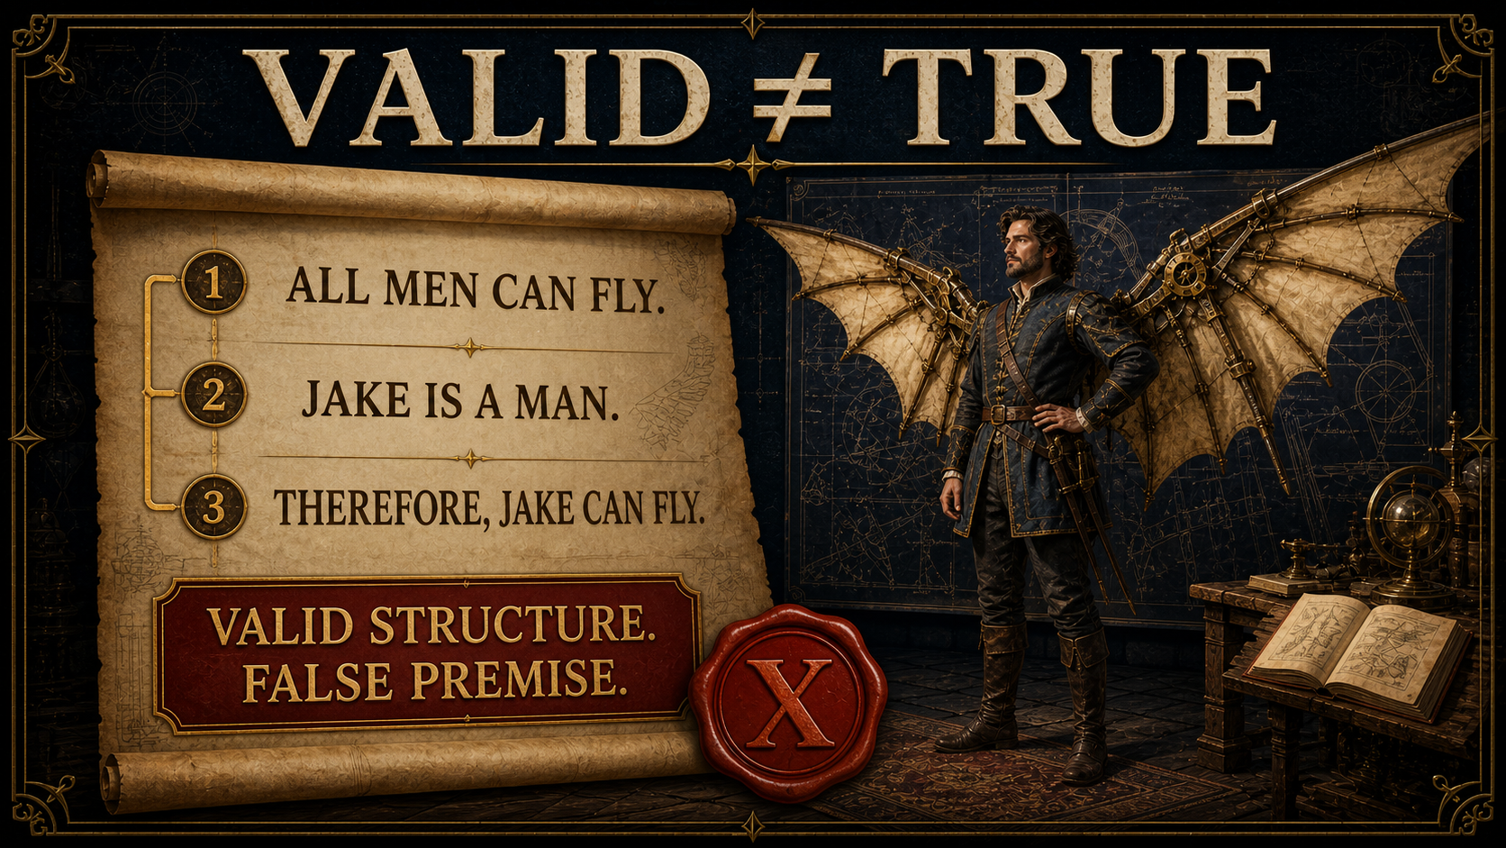
Notes:
Logic tells us whether a conclusion follows from its premises.
It does not guarantee that the premises accurately describe reality.
Good reasoning requires a valid logical structure, but what else?
The premise it is describing must reflect reality.
Give time deduction,
How do we know which one reflects reality? We need evidence, lets see how we gather that.

Slide 11
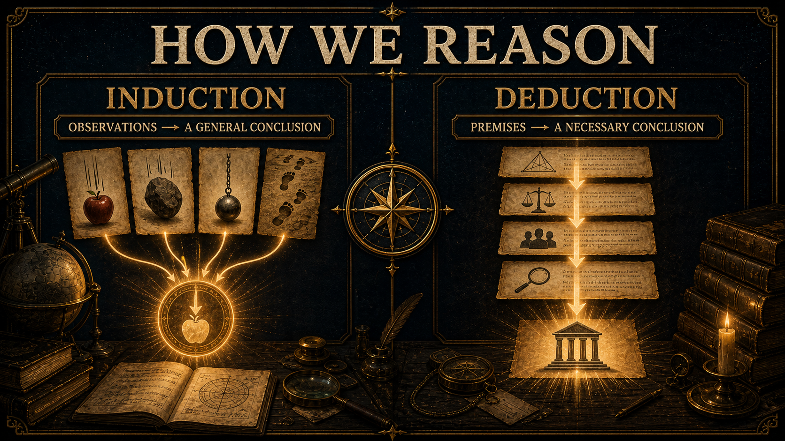
Notes:
Inductive reasoning begins with observations and moves toward a general conclusion. We observe that objects consistently fall toward the ground and infer a general principle concerning gravity.
Deduction begins with premises and draws the conclusion that follows from them. In ordinary life we use both: we observe the world, form conclusions, and then reason from those conclusions.
Inductive conclusions may be highly probable without being exhaustively certain.
Induction: All objects with gravity, or all men fly, no. cannot be 100 percent certain.
Deduction was used to confirm the logical time premise, ie mapping it out, prior trips, being told.
Perfect Induction, all particulars known, letters on a white page being black.
Deduction was used to confirm the logical time premise, ie mapping it out, prior trips, being told.
But even if it’s not perfect, we can be reasonably certain on a conclusion; give the prior example reasons (gravity, flying, time; which unforeseen can happen), These are all considered true beyond a reasonable doubt; its 99 plus precent sure, but it’s not beyond any doubt. It takes faith, maybe just a tiny bit depending, but faith none-the-less.
People say we rely on faith, so do they every day, chair holding you etc.

Slide 12
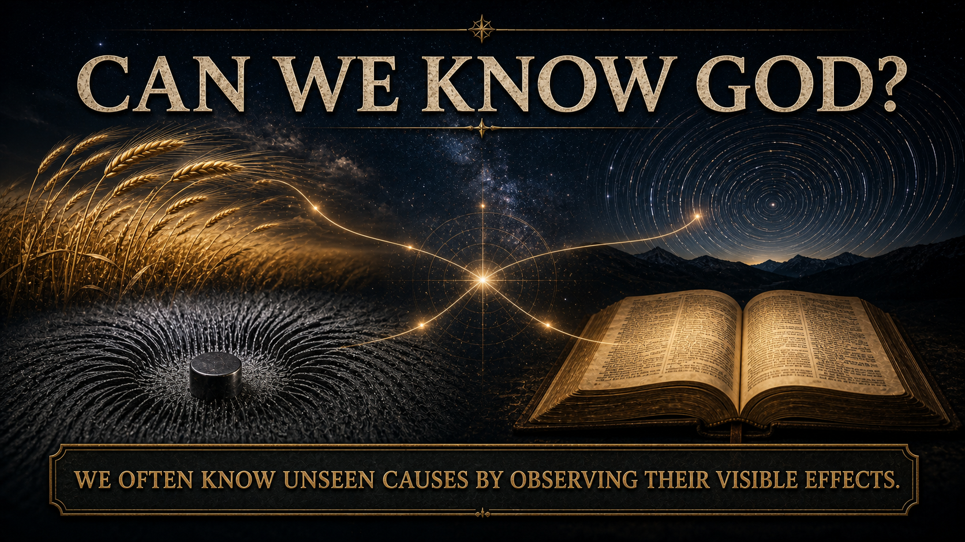
Notes:
David Hume, 18th Century philosopher, who was a renowned empiricist and skeptic, and Immanuel Kant, who died in he beginning of the 19th Century was a German philosopher centered on atheism and metaphysics
Hume believed that all meaningful ideas were either true by definition or empirically verifiable, veriable through your senses. The Principle of Empirical Verifiability
Read Hume Book Quote
Principle of Empirical Verifiability true by definition? No. Can it be verified empirically? No.
Kant says your mind and senses form all data, so you know nothing in itself, you only know what your mind and senses form.
tree is your mind forms it that way, you don’t know the tree in itself. Simpler, you can’t know the real tree, only as the tree appears to you.
Kant contradicts himself by saying no one can know the real world, while he is claiming to know something about it. Kant is saying the truth about the world is there are no truths.
The craziest part, both Kant and Hume affirmed the law of non contradiction.
CS Lewis said, “good philosophy must exist, if for no other reason, because bad philosophy needs to be answered.”
We do not directly see every reality we believe exists.
We infer gravity from its effects and another person's mind from meaningful communication and action.
The question is whether the world—its existence, order, intelligibility, moral experience, and history—contains effects from which truths about God may reasonably be inferred.

Slide 13
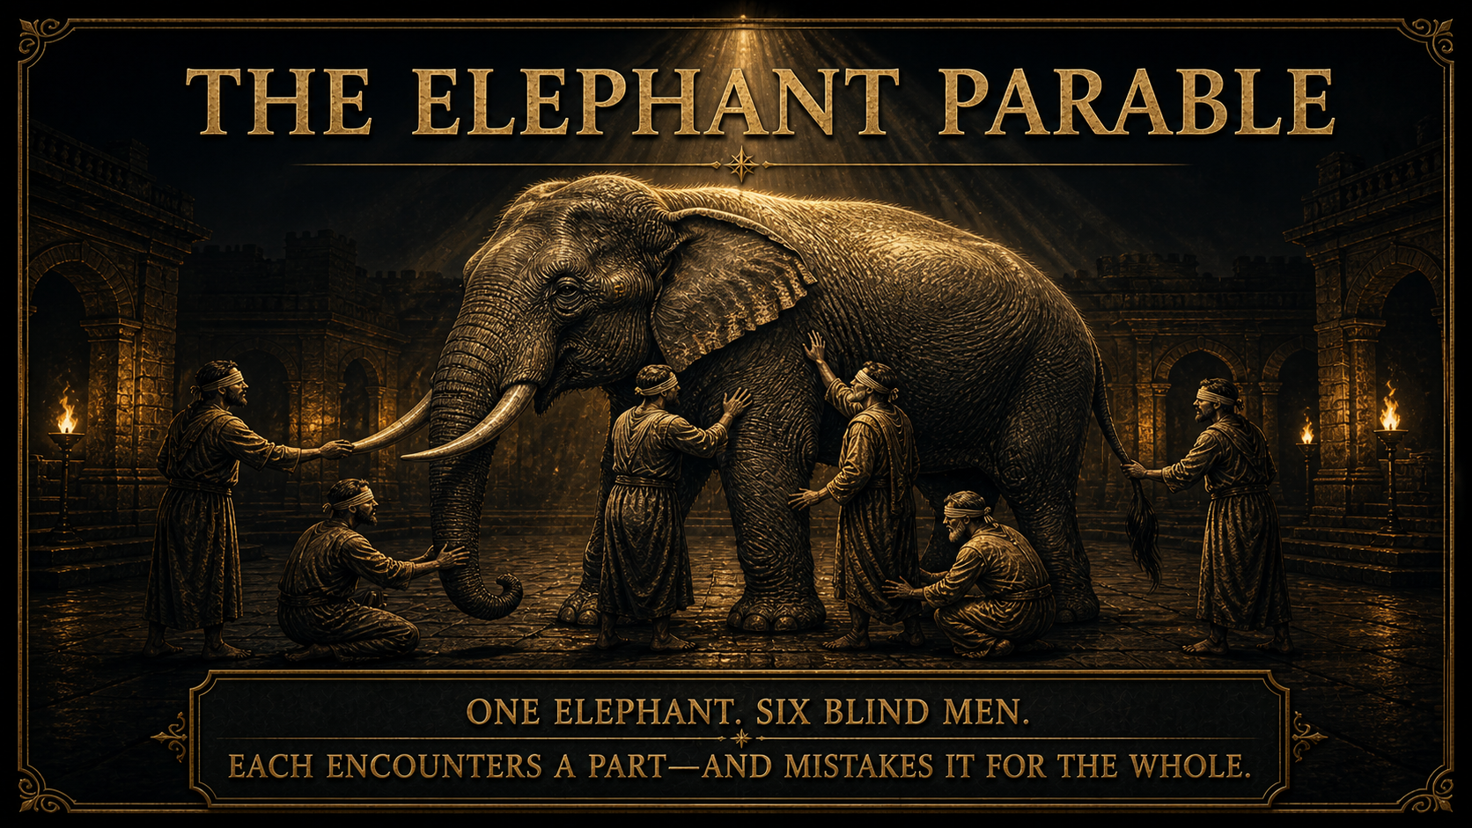
Notes:
This parable is dated long ago, 500 BC from the Tittha Sutta, which is scripture from the lifetime of Buddha, was a way to warn people of the limits of perception and the danger of claiming absolute truth. This is further proof, even before Christ, people were writing apologetics against Christianity.
However, as God does, Christian’s now used this as a positive argument for God, the opposite of its creation reason.

Slide 14
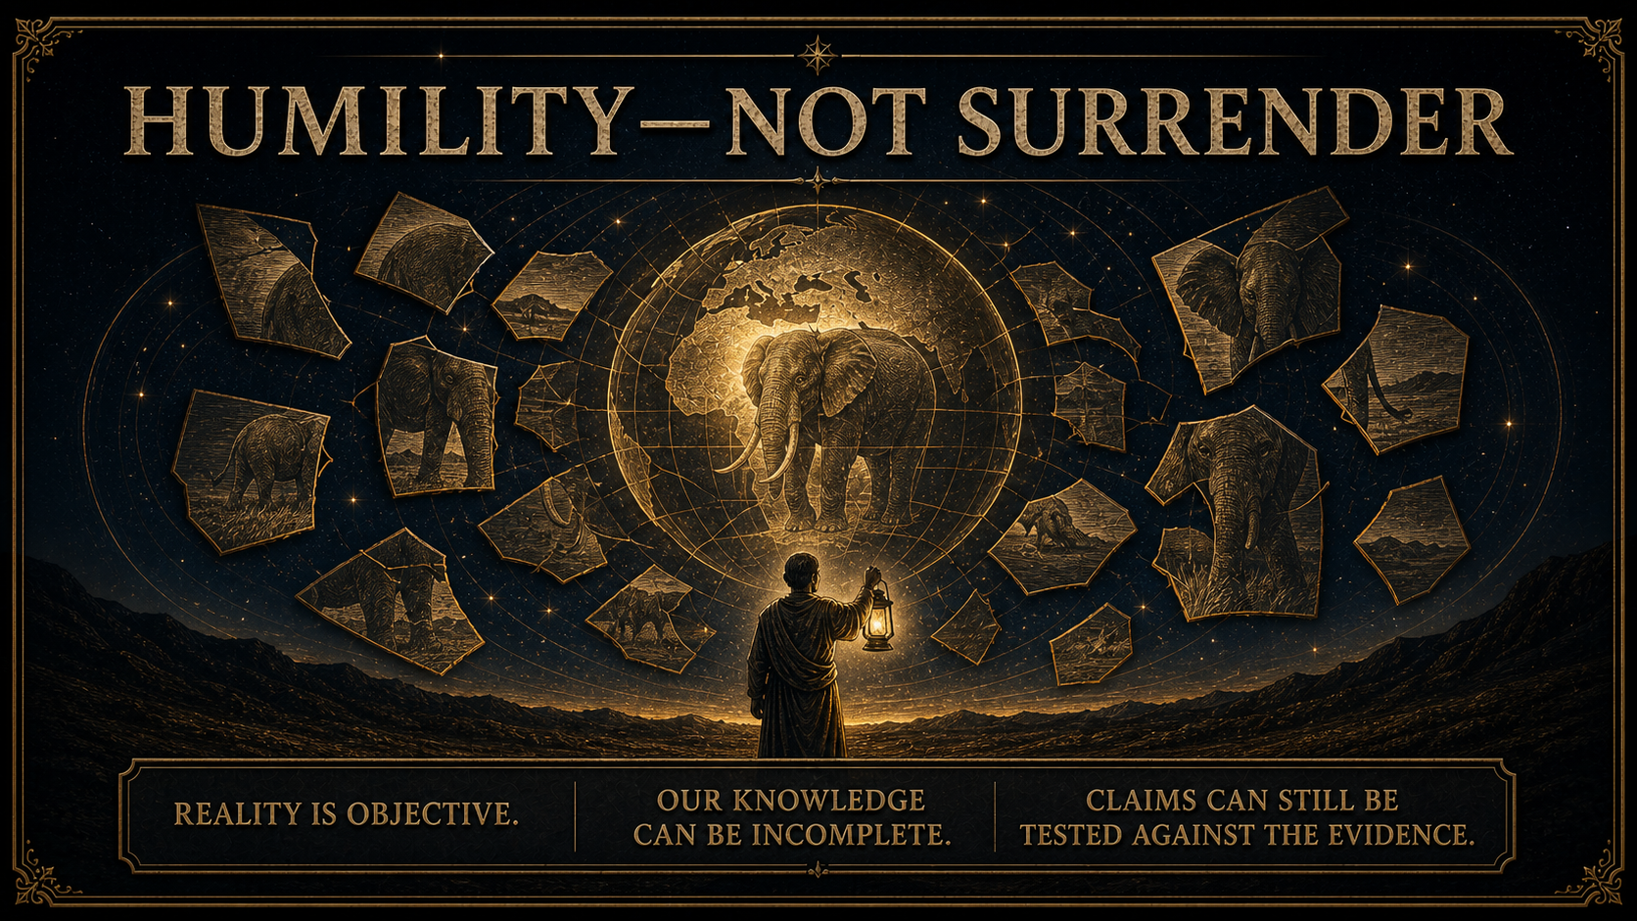
Notes:
The narrator can say that the blind men are mistaken only because the narrator sees the whole elephant from a broader perspective. The parable therefore assumes that an objective reality exists and that at least one observer can recognize it more accurately.
The lesson is not that every religious claim is equally true. It is that people can misunderstand reality when their evidence or perspective is incomplete. That should produce humility, careful listening, and continued investigation—not abandonment of truth.
The men are not all correct in the same sense. Each has encountered some evidence, but each has interpreted incomplete evidence as the whole truth.
That should produce humility—but not surrender.
If the blind were granted sight, they would be able to see they were mistaken.
If truth exists, we can continue investigating. We can compare explanations, test their consistency, examine their evidence, and ask which account best explains reality as a whole.

Slide 15
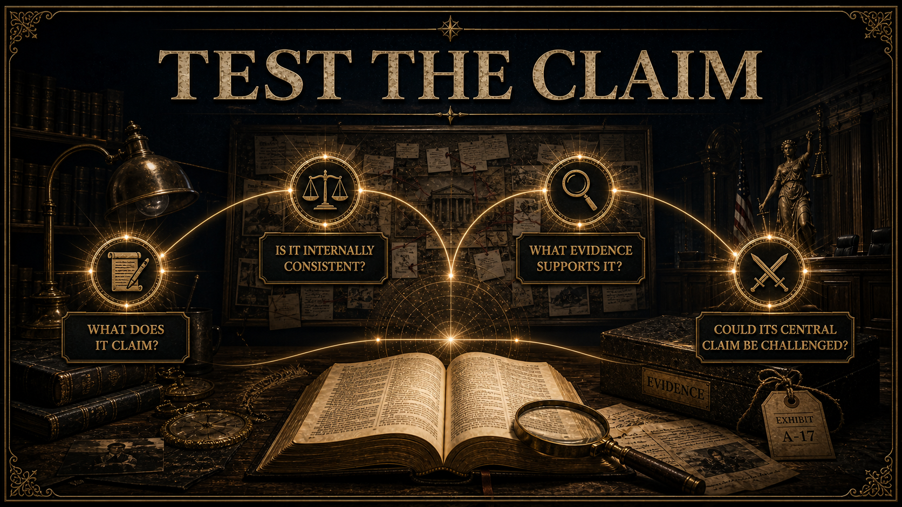
Notes:
Represent every religion accurately and evaluate it fairly. The goal is not to mock another faith or question the sincerity of its followers. Examine the nature of the central claim, how it is said to have been revealed, what evidence is offered, and whether independent investigation is possible.

Slide 16
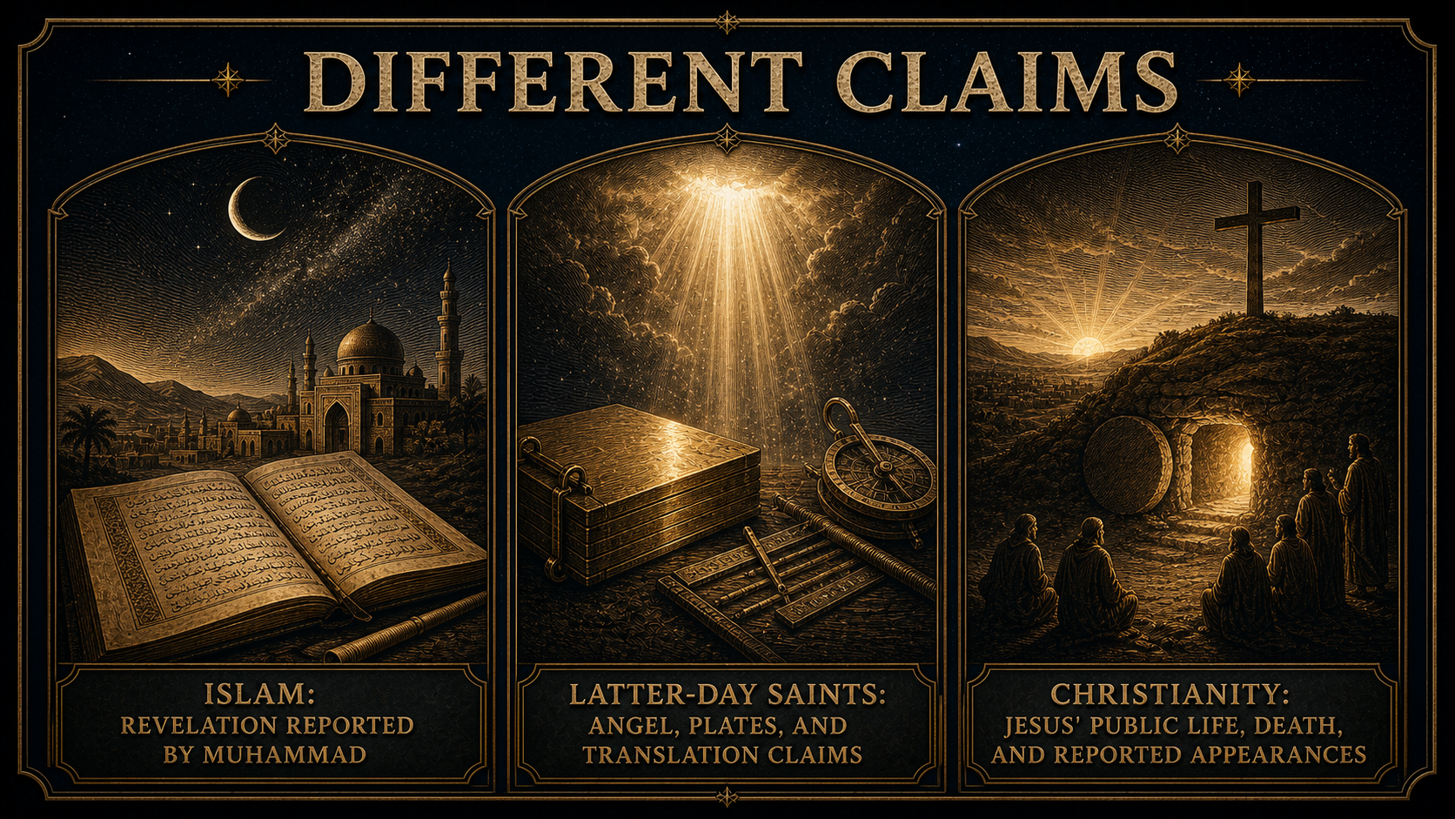
Notes:
We are gonna start by contrasting the severity of truth to our religion, let’s compare other religions regarding their claims.
Joseph Smith – 1823-1827 – three friends (close, money, scribe) first, eight others no angel, gets plates in 1827.
Transcribed the plates with hat and orb, claimed revelation
Muhammad, said to have received revelation from God, people witnesses “physical symptoms.”
Both by definition a “historical event.”

Slide 17
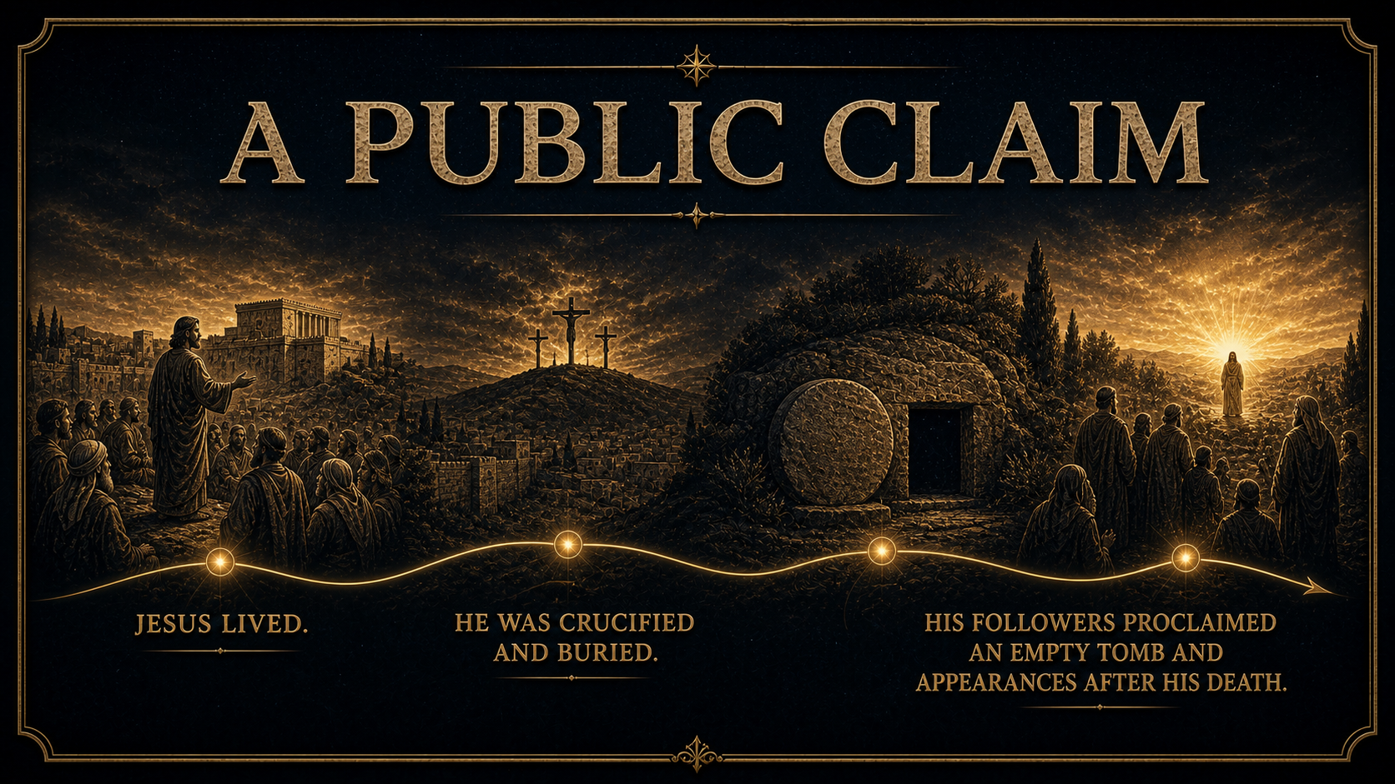
Notes:
Christianity centers on more than moral teaching. Its earliest proclamation says that Jesus died, was buried, was raised, and appeared to individuals and groups. Paul records appearances to Peter, the Twelve, more than five hundred people, James, the apostles, and finally himself.
Each claim deserves careful historical study. The point here is that Christianity places an alleged event—not merely a private insight—at the center of its message.

Slide 18
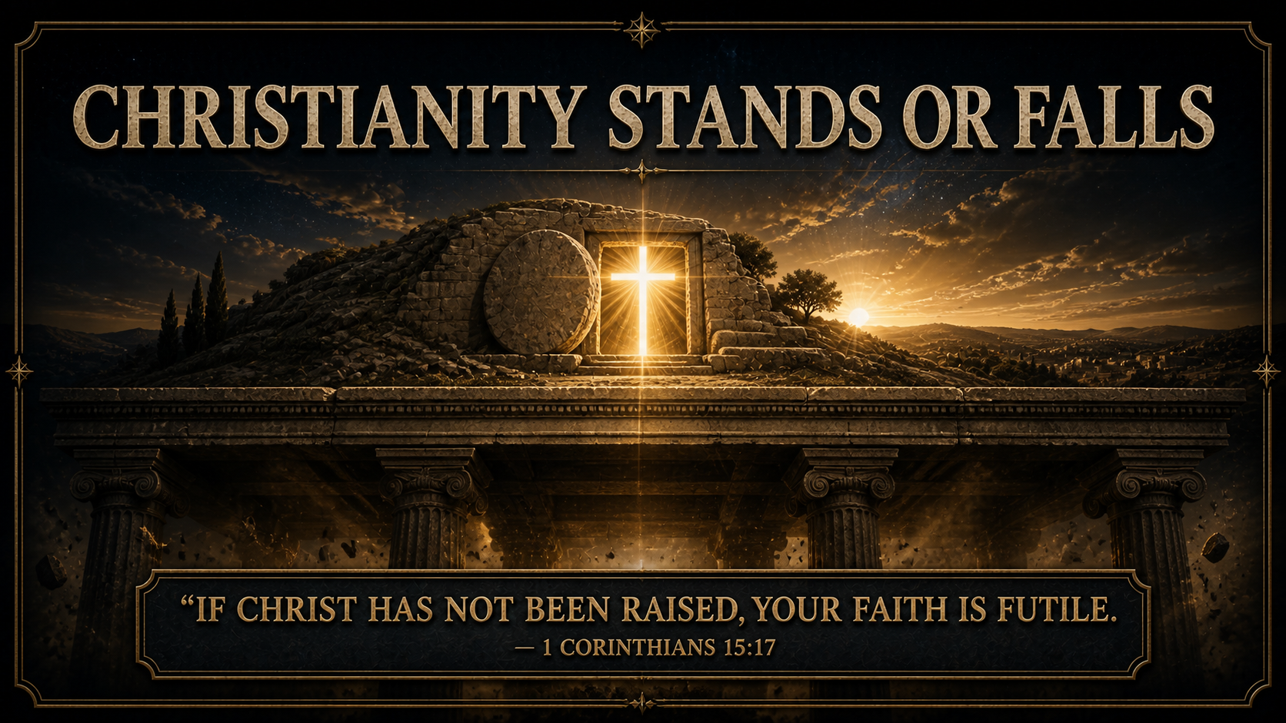
Notes:
Paul does not treat the resurrection as an inspiring symbol that remains useful whether or not it happened. He says Christian preaching and faith collapse if Christ was not raised. Christianity therefore identifies the claim upon which it stands or falls.
The closing question is not whether the resurrection is comforting. It is: What explanation best accounts for the evidence?

